Slide 1
Google Play Store Apps

Slide 2
Overview
Android Application developed
Selection of category, genre, and type (Paid or free)
Best Category to select

Slide 3
Tools
Numpy
Panda
Matplotlib / Seaborn
R package

Slide 4
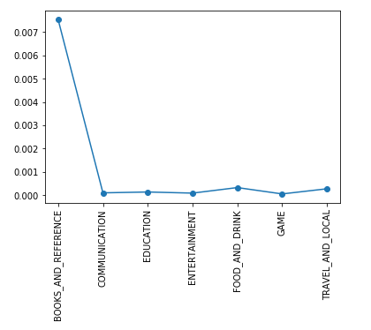
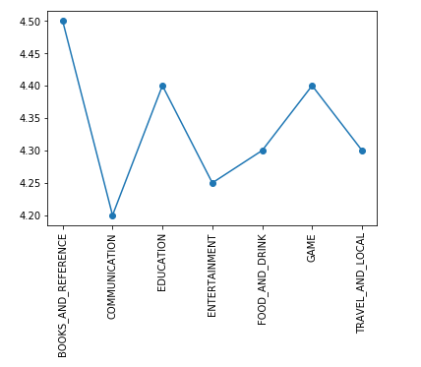
Empirical data view – Rating vs Relative Rating

Slide 5
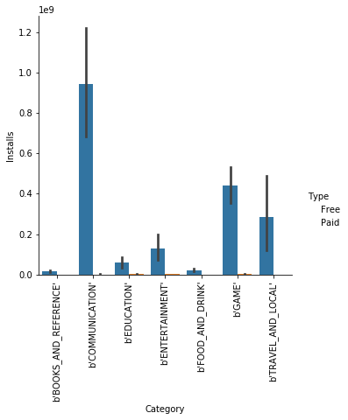
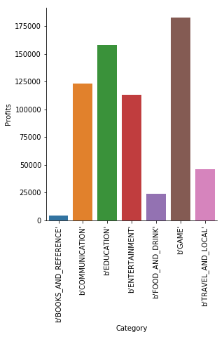
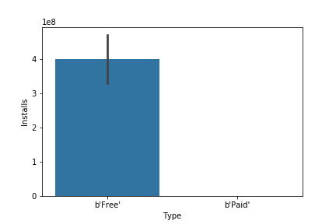
Empirical Data view – Type

Slide 6
Correlation between Categories
Find correlation between variables
Results were unpromising.

Slide 7
Conclusion
Further work needed find variables that correlate better
Temporary findings – Paid: Education, Free: Games

